Slide 1
Detecting Concept drift
BCs project
Janusz Wilczek
Supervisors:
Pınar Tözün and Robert Bayer

Slide 2
Concept drift

Slide 3
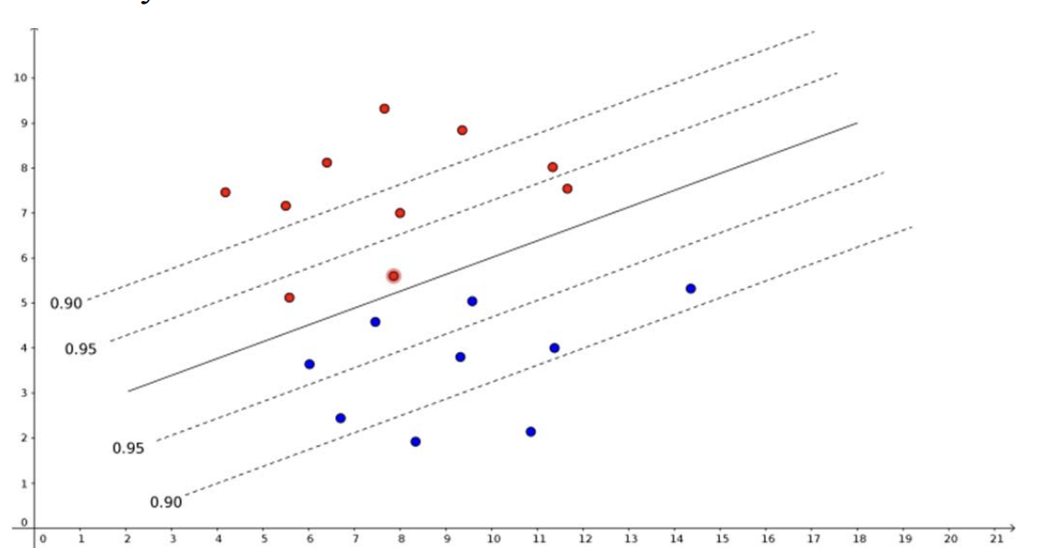
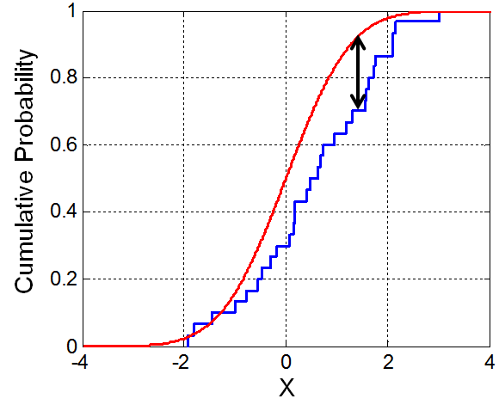
Detection methods
DDAL
Incremental Kolmogorov - Smirnov

Slide 4
Experiments
Mnist and CIFAR
Rotation and withhold class
Abrupt and gradual drift

Slide 5
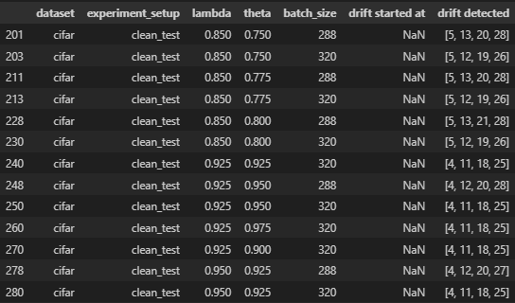
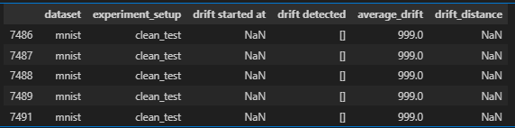
Finetuning DDAL

Slide 6
Baseline – only CNN model
Max CPU % | MAX Memory % | Avg CPU % | Avg MEM % | Time [s]
574 | 5.90 | 93.70 | 4.50 | 312
DDAL
Max CPU % | MAX Memory % | Avg CPU % | Avg MEM % | Time [s]
550 | 5.3 | 70 | 4.36 | 312

Slide 7
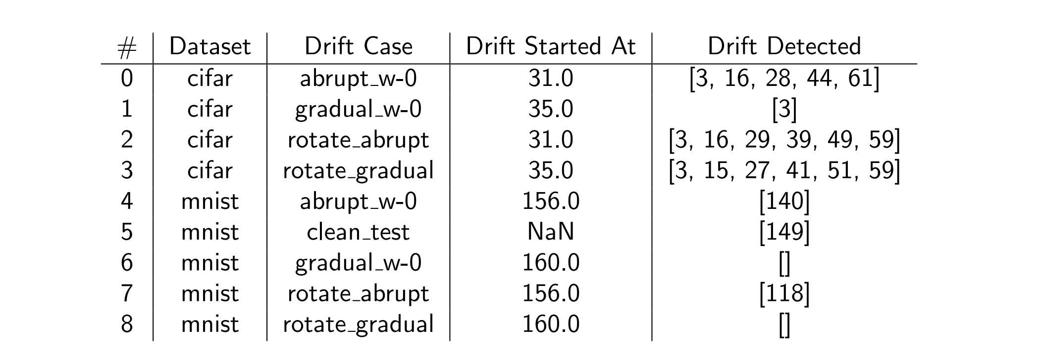
Results

Slide 8
Conclusions

